Slide 1
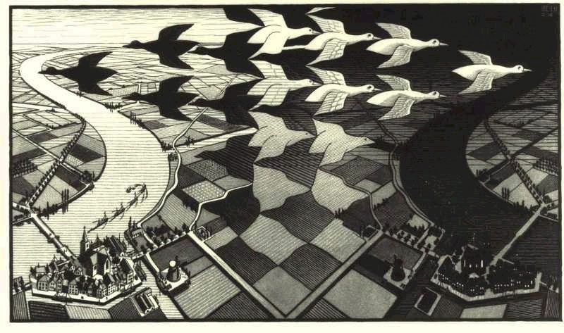
Pattern, Rhythm & Movement

Slide 2
Pattern
A principle of design in which the repetition of elements or combination of elements forms a recognizable organization

Slide 3
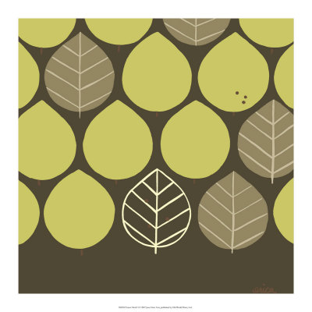
Motif
The two or three dimensional unit that is repeated to form a pattern

Slide 4
Planned Pattern
A consistent, orderly repetition of motifs
    (can be found in nature or created by an artist)
Planned patterns include row, grid, half drop, radial, alternating, and border.

Slide 5
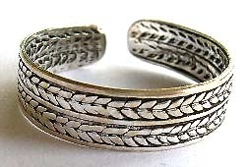
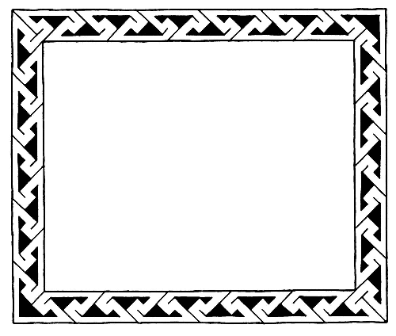
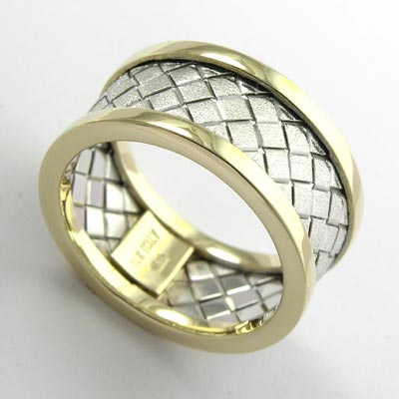

Row
Border / Band

Slide 6
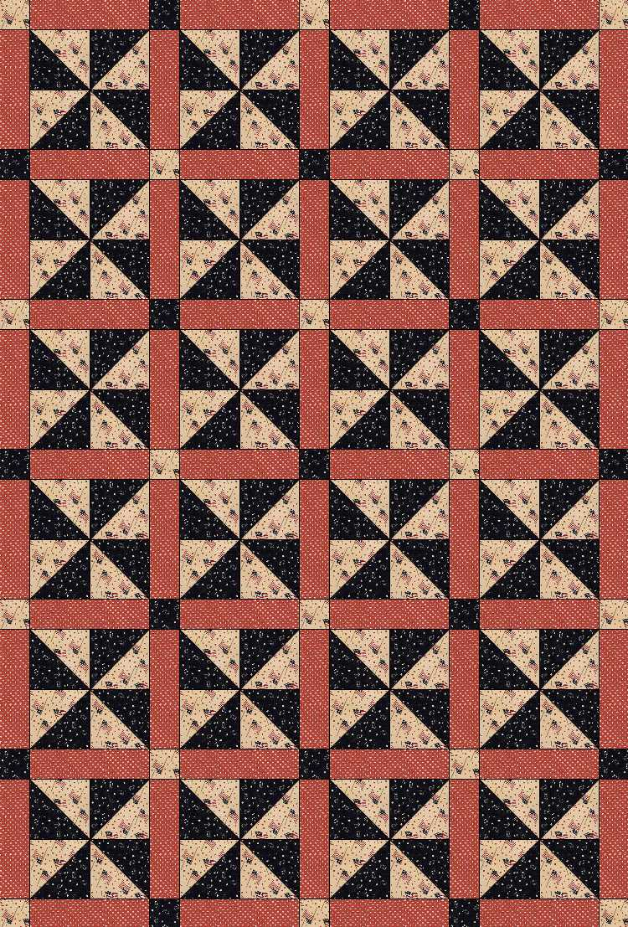
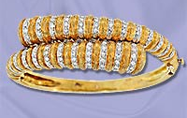
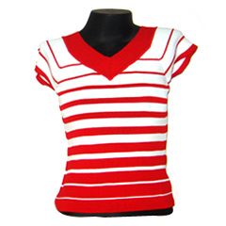
Grid
Alternating

Slide 7
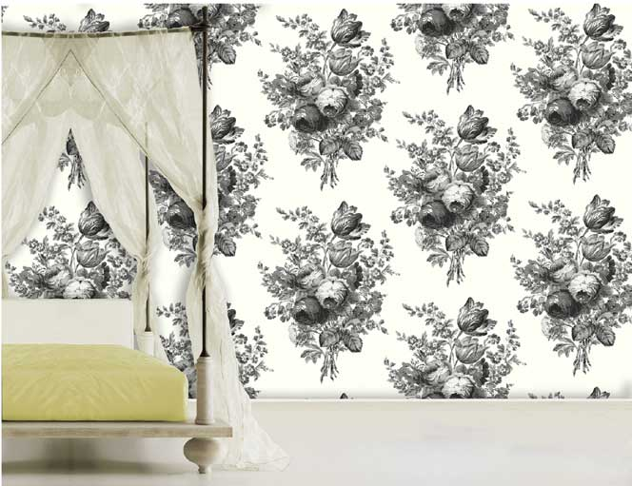
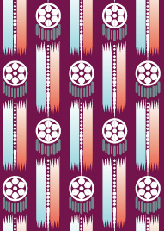
Half-drop
Each row is evenly spaced to half the height of its preceding row.

Slide 8
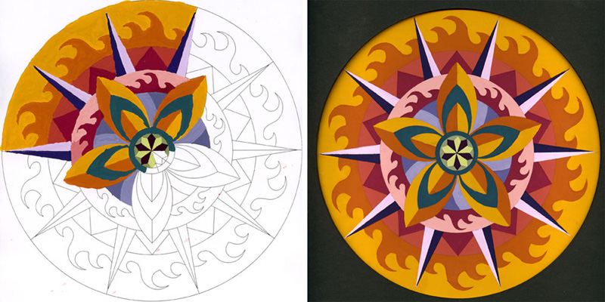
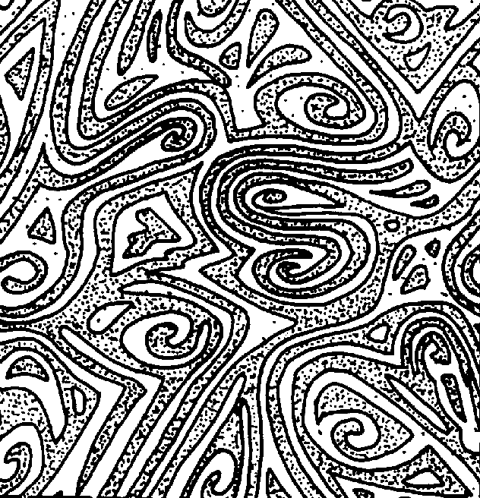
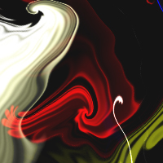

Radial
Random
A pattern created by chance without orderly organization

Slide 9
Visual Rhythm
The Repetition of an element to make a work seem active.
    You sometimes “feel” rhythm in a work of art as much as you see it.
    Artists use Rhythm to make an artwork come alive.
The VISUAL “Beat” in a work of art
    Produced by repeating one or several units/motifs of a design which helps create compositional movement.

Slide 10
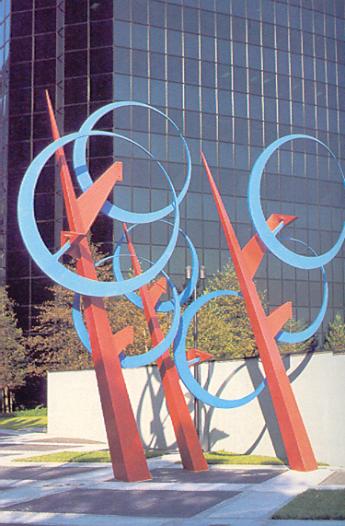
What element / motif is repeating?

Slide 11
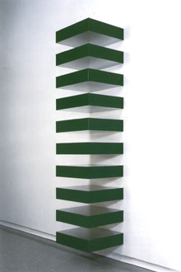
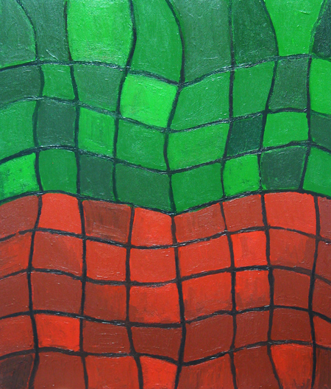
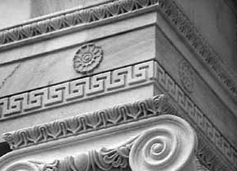
Types of Rhythm
Regular Rhythm - Created by a repeated pattern that is
predictable and continuous
Grid pattern
Row pattern
Border/Band pattern

Slide 12
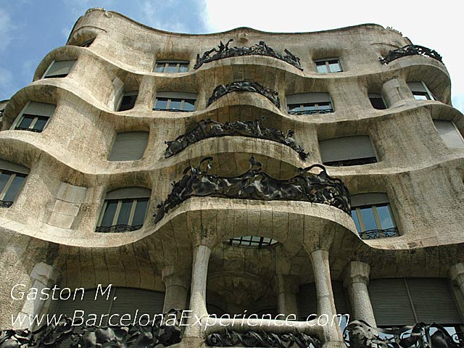
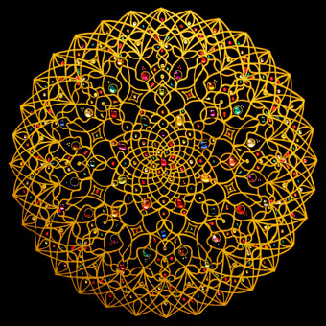
Types of Rhythm
Flowing Rhythm - Large movement that sweeps across the entire
artwork and ties things together
Flowing rows
Radial pattern

Slide 13
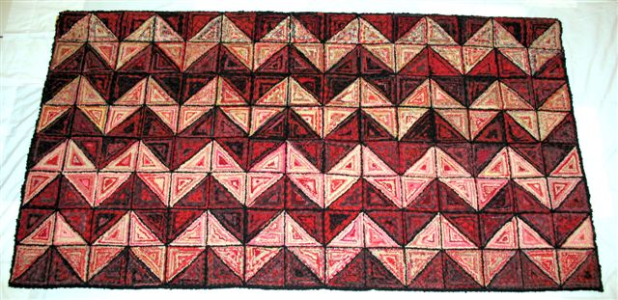
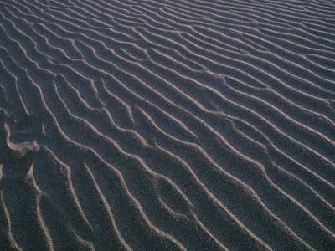
Types of Rhythm
Alternating Rhythm - Created by a pattern that switches back and forth to add variety to the movement

Slide 14
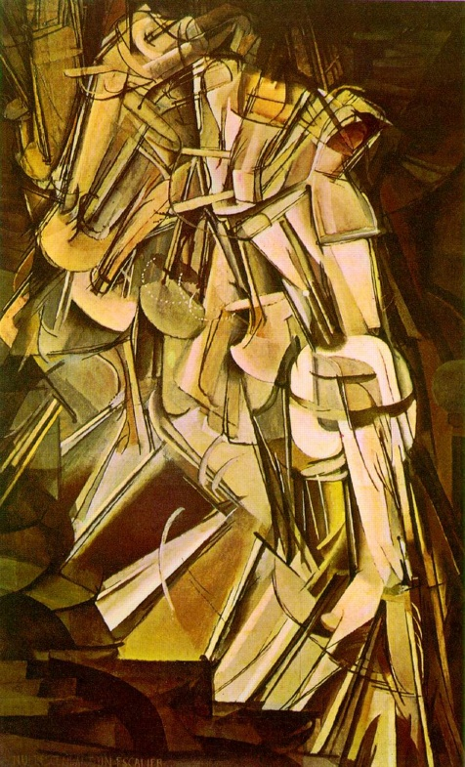
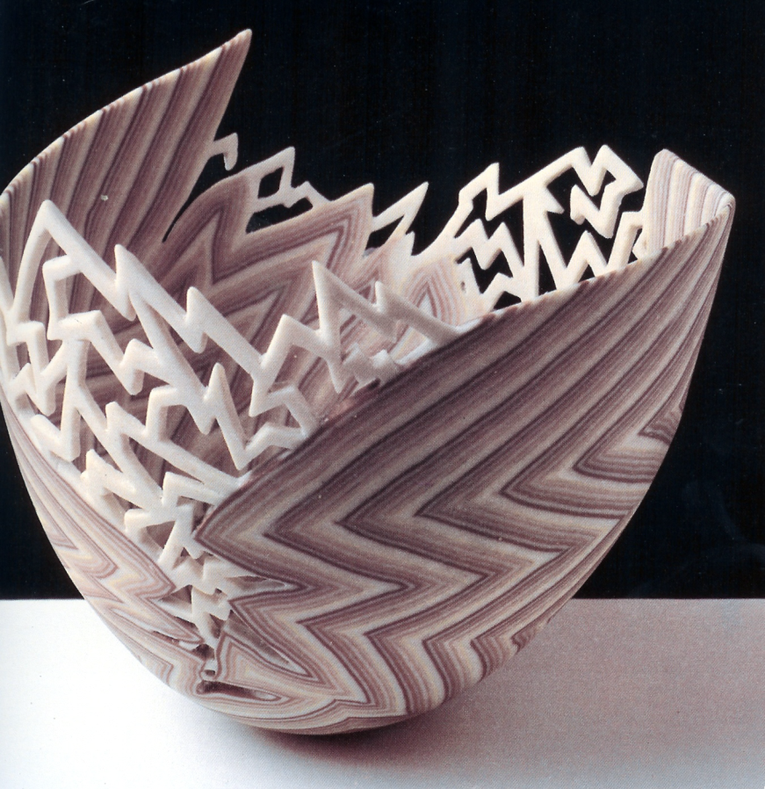
Types of Rhythm
Progressive Rhythm - Created by a repeating pattern whose motif changes in a predictable or regular way (ie: increases/decreases)

Slide 15
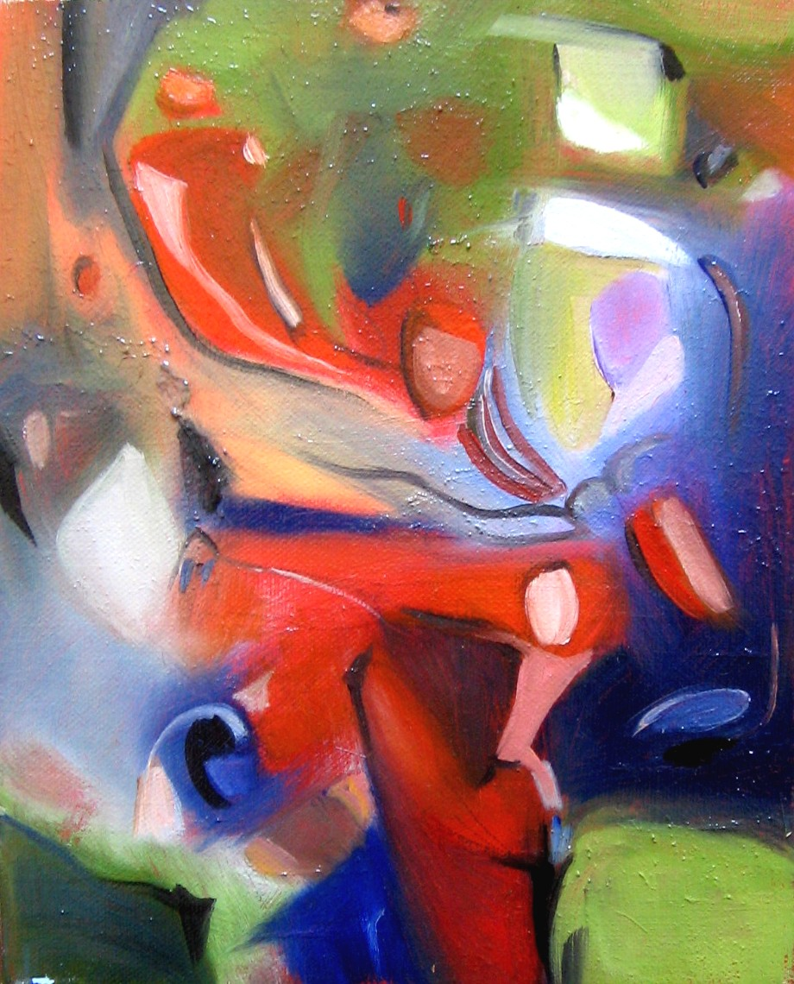
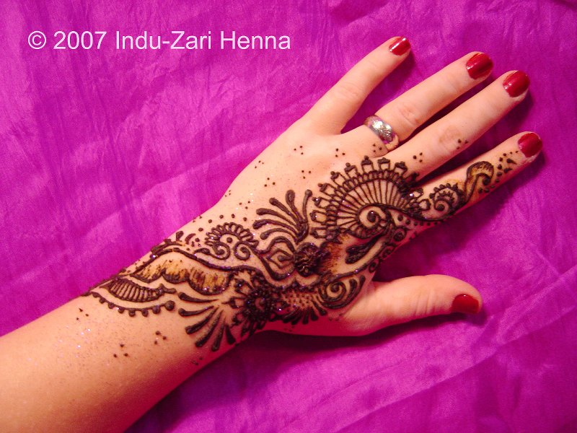
Types of Rhythm
Unexpected Rhythm - Created by an irregular, jerky or spontaneous repetition and pattern
Random Pattern

Slide 16
Movement
The principle of art used to
    Guide the viewer’s eye through the picture
    Create the look and feel of action
Artists create movement through the careful blending of elements

Slide 17
Compositional Movement
A path that the viewer’s gaze is directed to follow because of the arrangement of elements in an artwork.
    Artists may use a circular or linear direction for the viewers eyes to follow

Slide 18
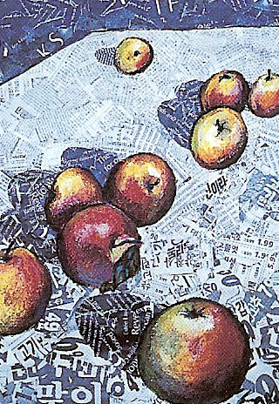
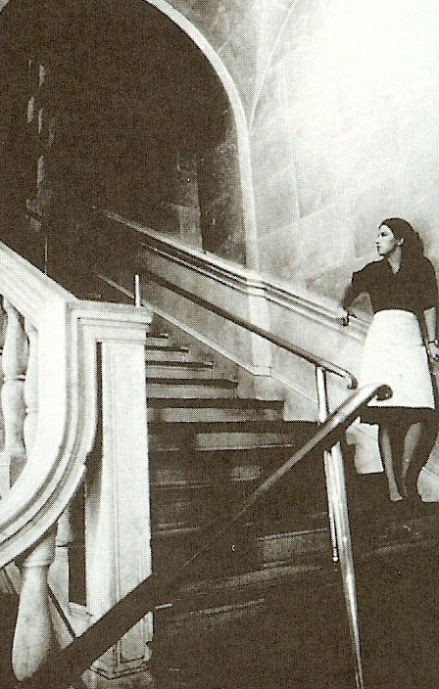
Linear Movement

Slide 19
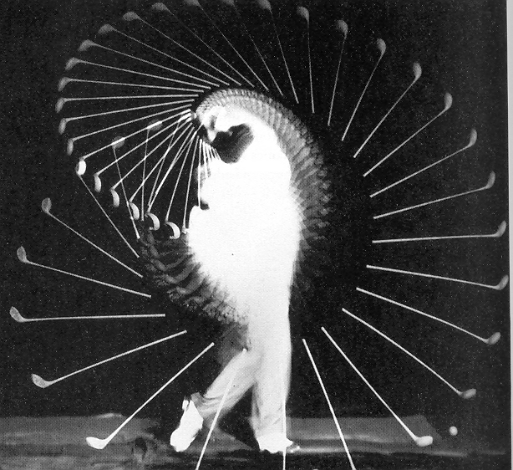
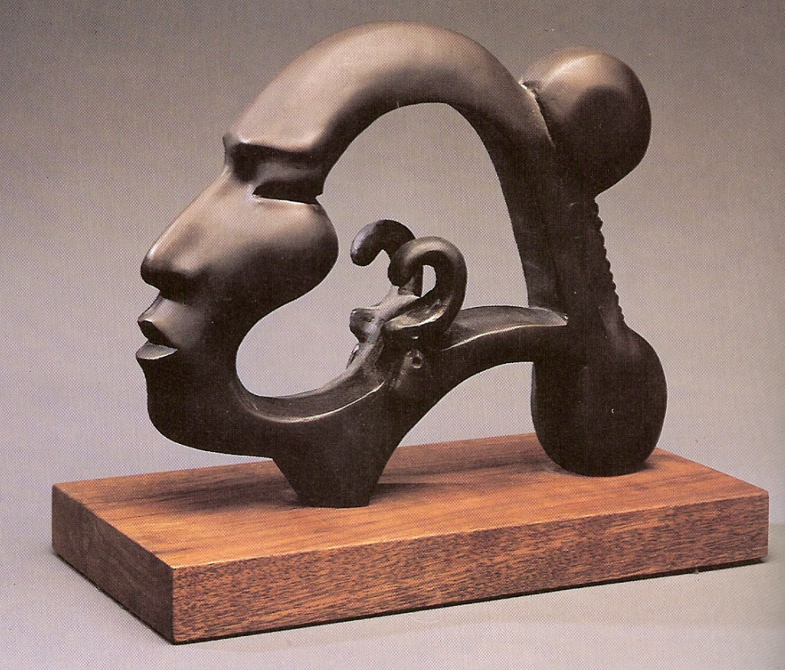
Circular Movement
3-D Artists also create movement in the direction in
which he/she wants the viewer to walk around the work.

Slide 20



Pattern/Rhythm/Movement Morph
Animation Project
Each student will create a series of drawings that morph in shape, color, pattern, and or texture while creating visual rhythm and movement
All the drawings will be linked together to create a class animation
Animation Example

Slide 21

Animation Morph Rubric
Composition
  Elements of design are used to create a complex morph
  Eye movement is created throughout the drawings
Creative Expression
  Interesting use of pattern, rhythm and movement
  Creative Morph within object
Craftsmanship
  Drawing is clean and neat
  Stray marks are not visible
  Drawings line up well with each other
Skill
  Smooth transition from one drawing to the next
  Application of pattern, rhythm and movement is sophisticated
Objectives
  Minimum of 10 frames
  Apply Pattern, Rhythm and Movement to the Morph Drawings
  Create a complete morph that has a beginning and an ending (must be the template shape)
  Drawings are finished in color or value
Single Project
Example

